Slide 1

Lecture : 4 Mechanics & Gravitation

Slide 2
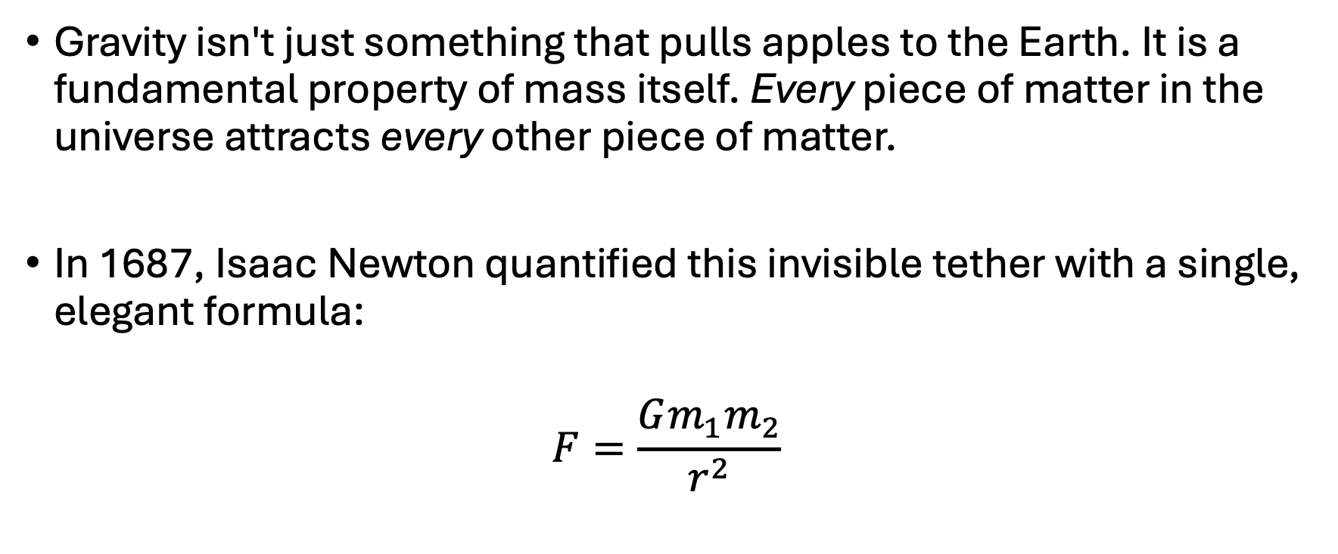
Newton Law’s of Gravitation

Slide 3
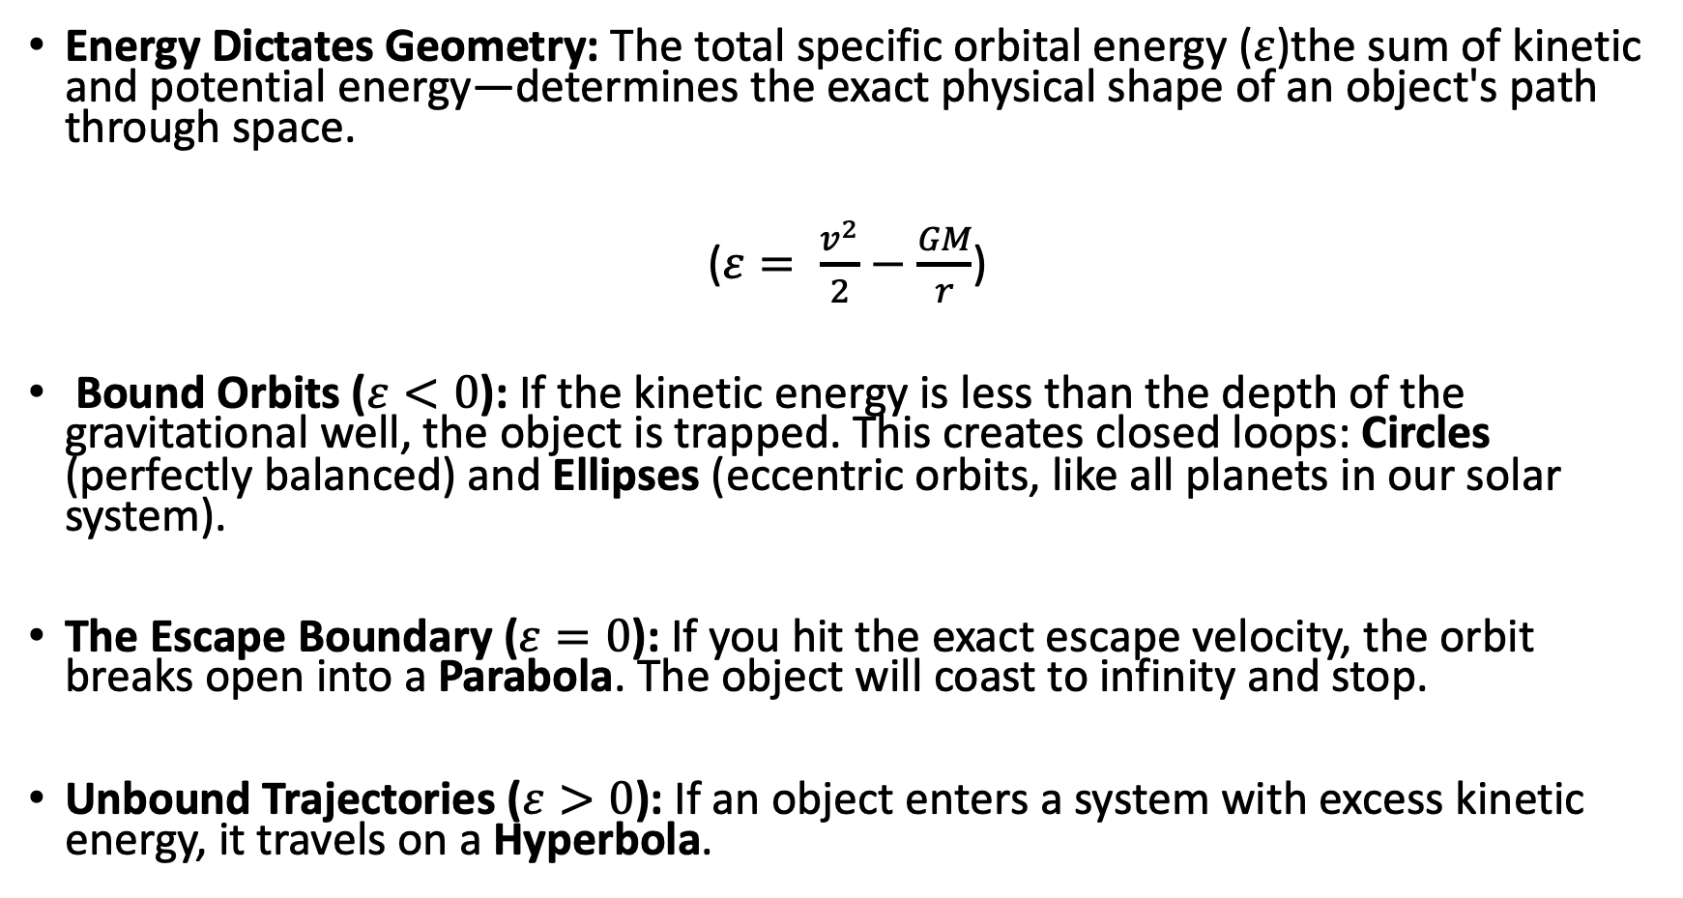
Orbital Mechanics

Slide 4
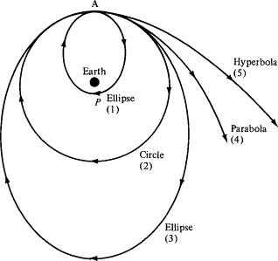

Slide 5
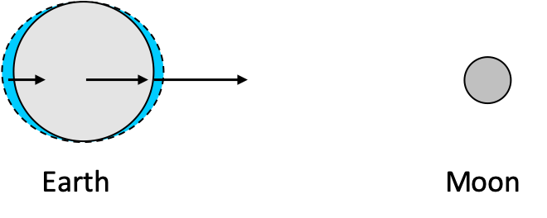
Tidal Forces
Gravity weakens with distance, so the near side of an object feels stronger pull than the far side.
Tidal Bulges: This difference stretches bodies, producing ocean tides on Earth.
Tidal Locking: Over time, rotation synchronizes with orbit, as seen in Earth’s Moon.

Slide 6
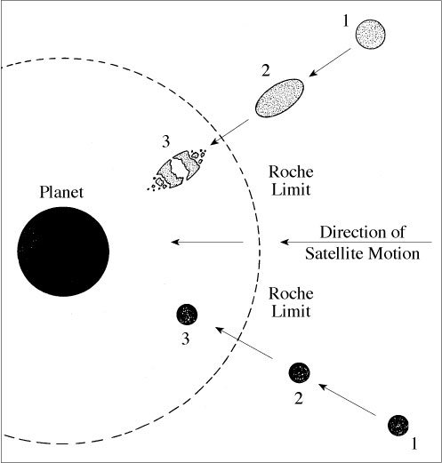
Roche Limit
Definition: The minimum distance at which a satellite can orbit without being torn apart by tidal forces.
Structural Dependence: Rigid bodies survive closer than fluid bodies.
Ring Formation: Planetary rings often form from material inside the Roche limit.
Mathematical Form: Depends on densities of primary and secondary bodies.
Cosmic Sculptor: Explains why moons are absent within certain orbital radii.

Slide 7
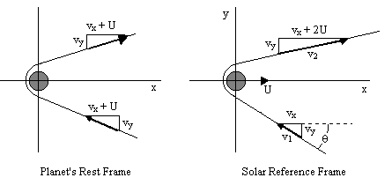
Gravitational Slingshot
Momentum Exchange: A spacecraft can gain or lose orbital energy by passing close to a moving planet.
No Free Energy: The spacecraft steals a tiny amount of the planet’s orbital momentum. The planet slows by an immeasurable amount.
Velocity Boost: In the Sun’s reference frame, the spacecraft exits with greater speed than it entered.
Trajectory Bending: The planet’s gravity curves the path like a cosmic billiards cushion.
Mission Game-Changer: Enables deep space missions without carrying impossible amounts of fuel.

Slide 8
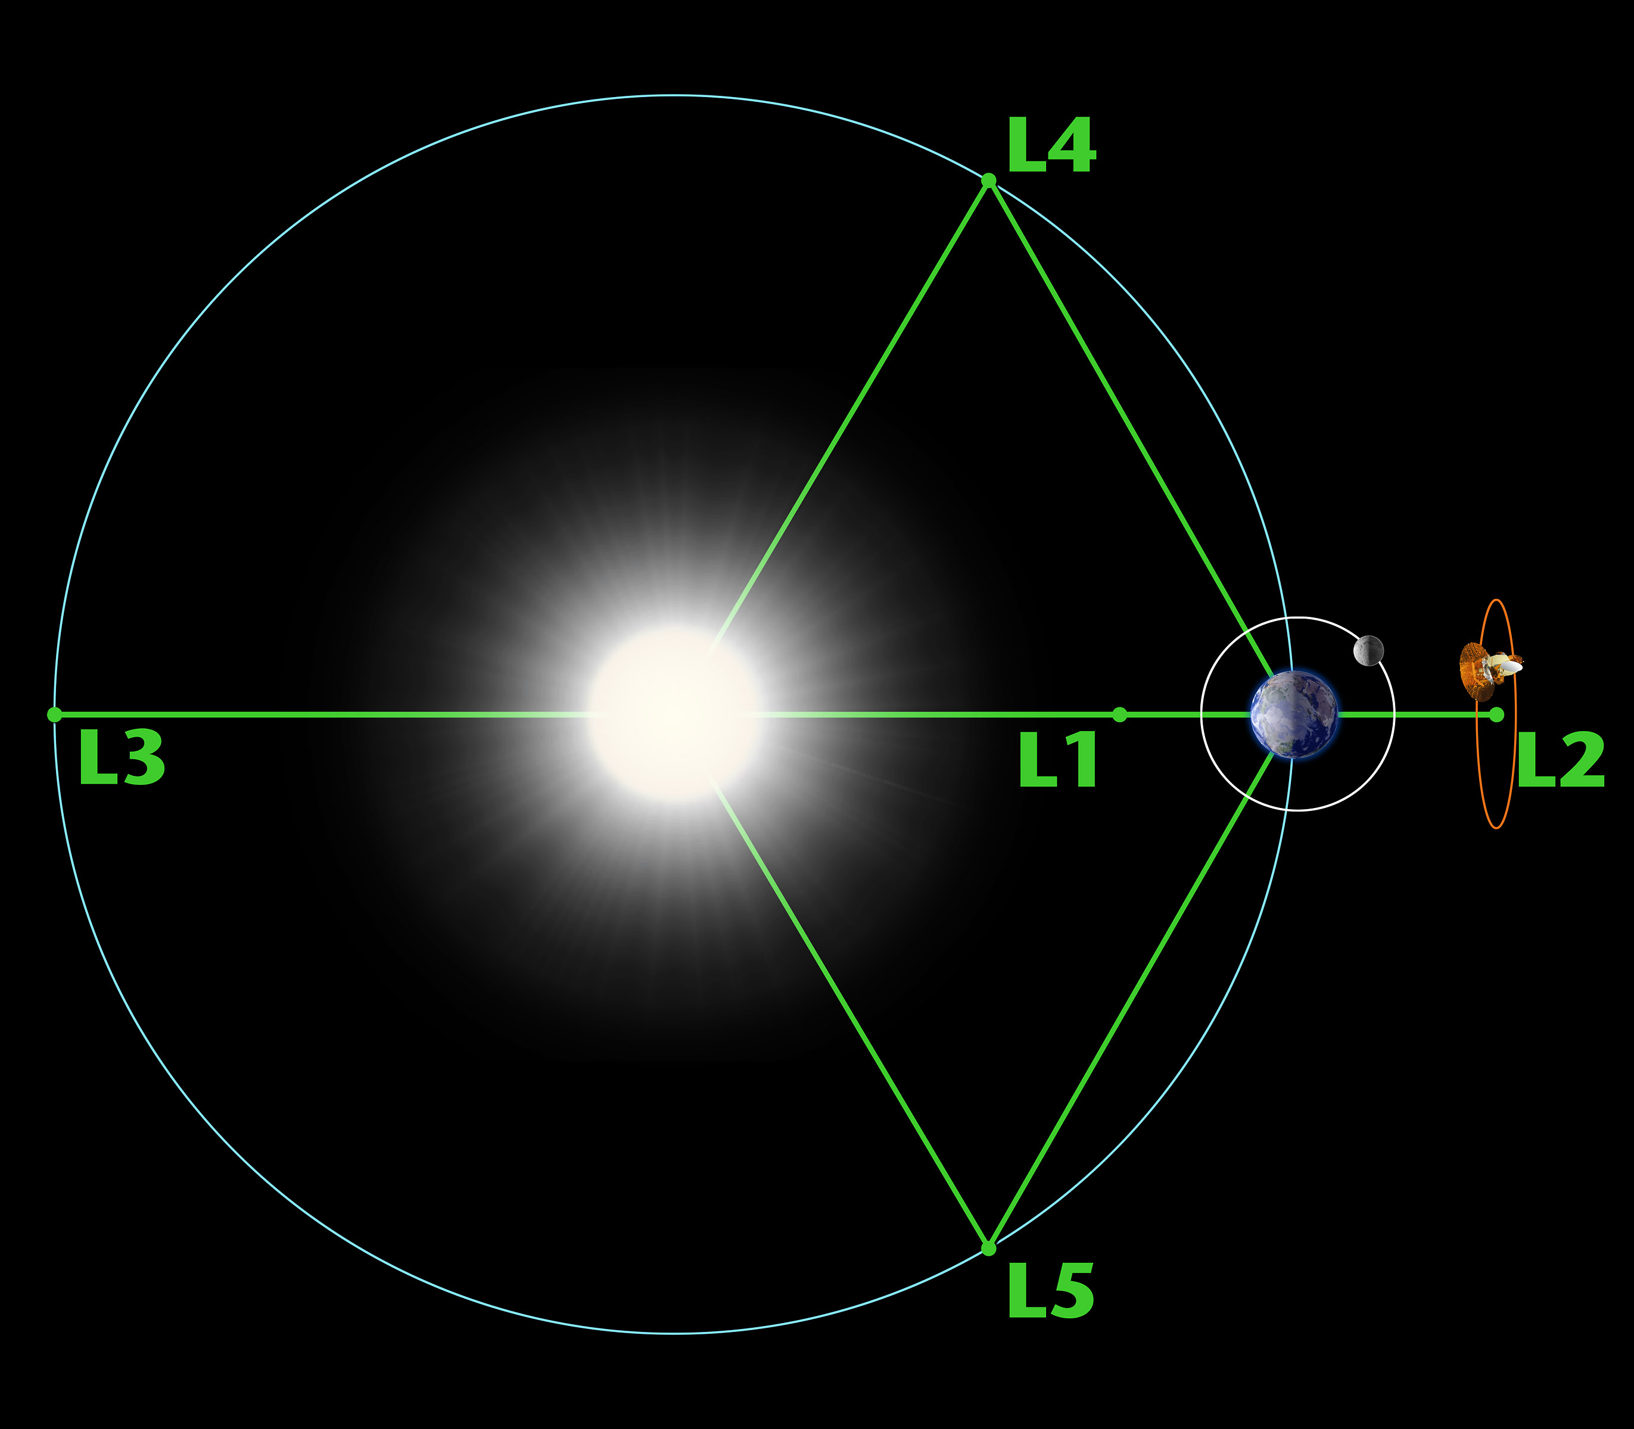
Lagrange Points
Gravitational Equilibrium: Lagrange points occur where gravitational forces of two massive bodies and orbital motion balance perfectly.
Five Special Locations: L1, L2, L3 lie along the line connecting the two bodies. L4 and L5 form equilateral triangles with them.
Stable vs Unstable: L4 and L5 are naturally stable. L1, L2, and L3 require active station-keeping.
Strategic Real Estate: Ideal for space telescopes and observation satellites.
Minimal Fuel Advantage: Objects placed here require very little energy to maintain position.

Slide 9

sarthak.phys@gmail.com

Slide 10


